Slide 1
ZFPSST Supplier Packaging & Label Guideline
SCM Requirements
Version 07 , 24-Jul-24
Kathawut Netiniyom | Supply Chain Department | ZF Passive Safety Systems (Thailand) Co., Ltd.

Slide 2
Packaging Requirements from Warehouse & Transportation
SU (Shipping Unit) dimension & weight should be fit with our selective rack design & max load capacity.
    Dimension will not exceed Length x Depth x Height (mm) : 1000 mm x 1200 mm x 1000 mm. (L x D x H included pllt)
    Gross weight will not exceed : 900 Kgs / SU
    Individual cartons will not exceed : 13.6 kgs
Q’ty per box should match with our kitting plan by multiply of 10 depend on factors below
    BOM usage (1:1, 1:2, 1:10 and so on)
    Part dimension (Big, Small)
    Volume
    Weight
Label is required to follow ZF standard 2D barcode template & require two labels to be located on an adjacent side (Barcode labeling specifications can be found in page 4 : Supplier Printed Label).
Pallet 4 ways (only Wooden pallet with Fumigation or Plastic pallet is allowed, Paper pallet is not allowed).
For returnable boxes, we need modular type for mixed pallet with cover lid/sheet to protect dust (this is important for future Milkrun).
All returnable packaging need to Mark company name, Box serial no., Tag holder 2 adjacent sides.
Rust / Corrosion prevention (VCI) is required for metallic parts to avoid rusty during long transportation.
Stretch wrapped or banded for shipping unit is mandatory required to protect part collapse during transportation.
Shipping unit (SU) dimension should not over pallet size (no overhang), it risks for accident and part damaged.
Shipping unit (SU) is allowed to stack total 2 layers but need to add Carton Corner Protectors to prevent deforming for the heavy parts.

Slide 3
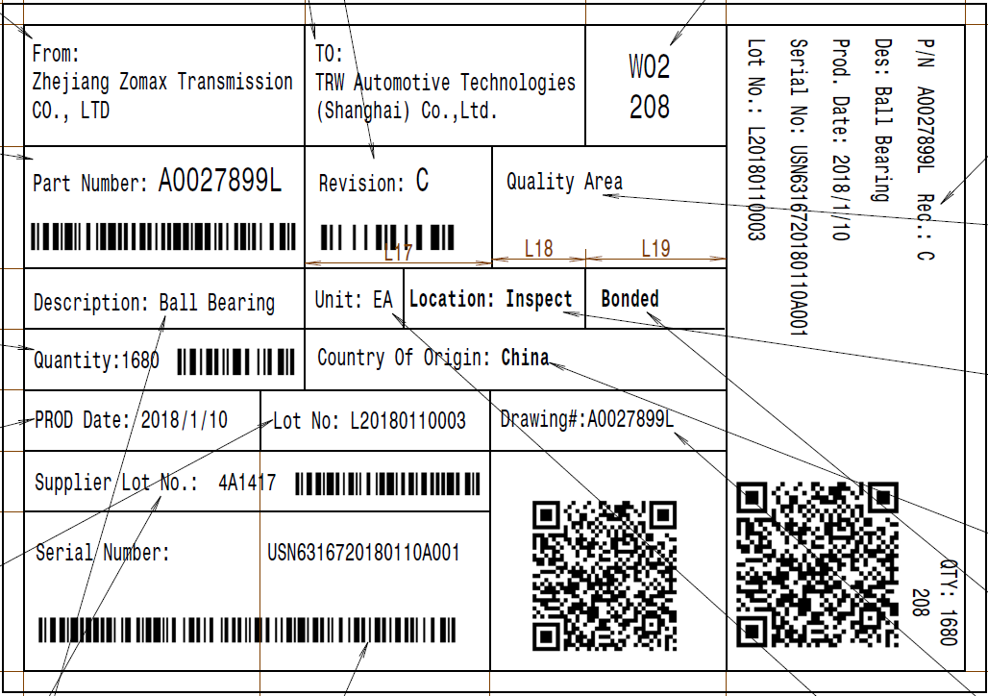
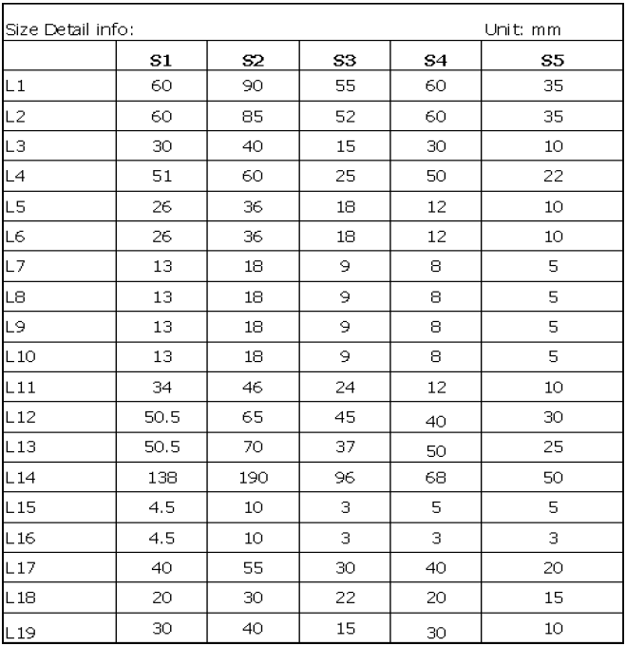
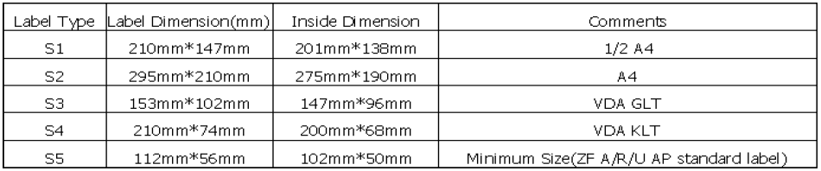
Supplier Printed Label
(5 label type for selection with dimension)

Slide 4
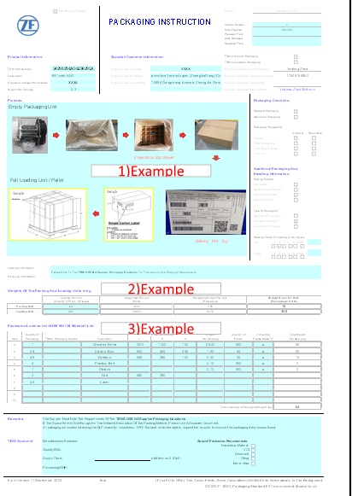
Please provide the detail as possible
1.Please include pictures to understand the details of the packaging
2.Detail for Weights Of The Packing And Loading Units In kg
3.Detail for Packaging Loading Unit BOM (Bill Of Material) List

Slide 5
Reference Guidelines

Slide 6
Log Sheet
Version | Description | Created by | Released Date
V.00 | New release. | Kathawut N. | 26-Apr-18
V.01 | Add SU is allowed to stack total 2 layer but packing spec need to be able to carry the whole weight of 2 stacked layer in item 9. | Kathawut N. | 30-Apr-18
V.02 | Change gross weight from 800Kgs to 900Kgs Change individual carton box weight from 10Kgs to 13.6Kgs in item 1. | Kathawut N. | 11-Jun-18
V.03 | Remove quantity per box option multiply by 1 piece from item 2. | Kathawut N. | 21-Jun-18
V.04 | Add carton corner protectors for 2 stacked-shipping unit in item 9. | Kathawut N. | 26-Nov-18
V.05 | Add requirement of supplier printed label | Kathawut N. | 20-Sep-19
V.06 | Add an example of filling in the details of packaging | Maitree W. | 06-Jul-21
V.07 | Change company name & company logo to ZF Passive / Lifetec | Kathawut N. | 24-Jul-24

